Slide 1
EECS 452 - MDE Project Introduction
Nick Farid, Jack Getty, James Wishart, Justin Yu
Notes:
Hello, my name is Nick Farid
Today I will be introducing our EECS 452 MDE Project. I am presenting on behalf of my team, which includes Jack, James and Justin as well.

Slide 2
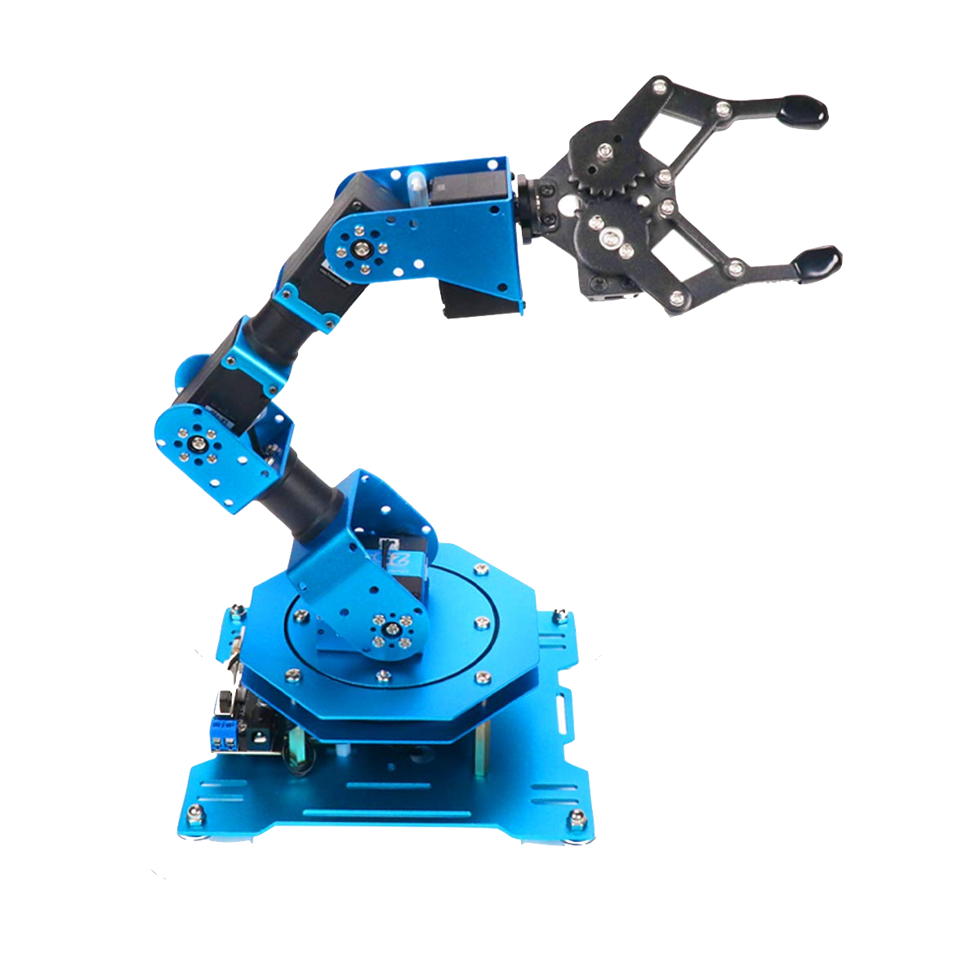
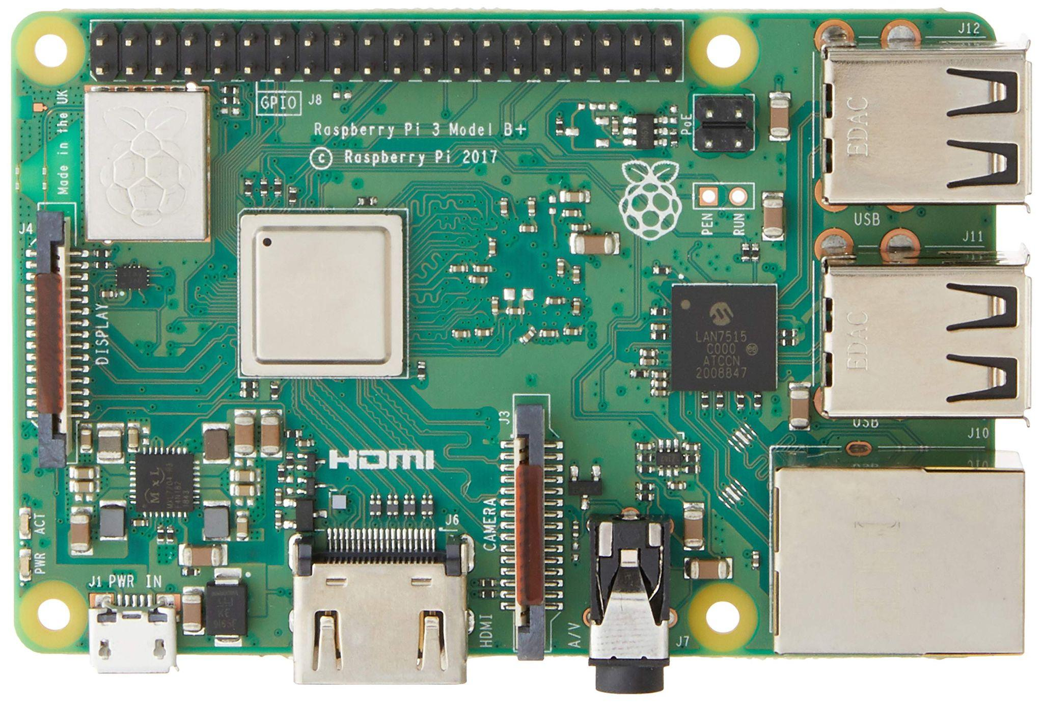
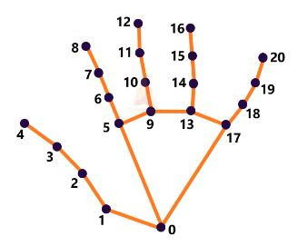
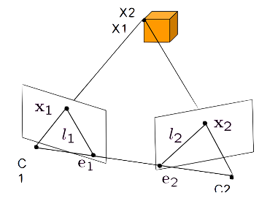
Overview
Milestones &
Challenges
Background
Proposal
Methodology
Notes:
Before moving on, I wanted to provide you with a brief overview of what we will discuss today.
First I will discuss the background and requirements of our project in order to provide you with important context.
Next I will provide an introduction to our idea. Following this I will provide you with an overview of our design methodology.
I will then provide a more detailed breakdown of what we have achieved and how we plan to implement the rest of our design. And then we will finish off with a few concluding remarks.

Slide 3
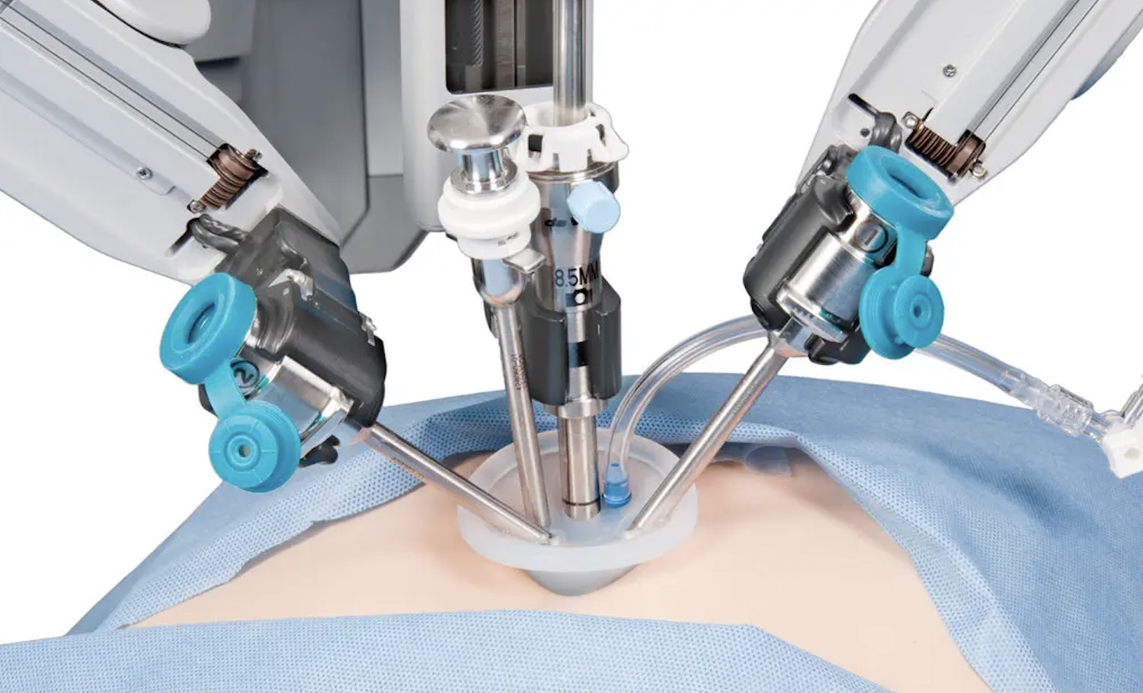
Intuitive tele-operation of robots is important
Notes:
Our proposal is to create a robotic arm that moves as a result of a user’s hand movements. We plan to create a robotic arm with six degrees of freedom. The six degrees of freedom can be observed on the slide. It is important to note the notion of six degrees of freedom represents the minimum regions of movement required by a robot in order to occupy every volume of space within its reach.
We believe that our idea is a novel and unique approach to fulfilling the projects requirements, because the same concept can be applied important applications like surgery robots which can correct a user’s mistakes and increase precision during high risk surgeries.

Slide 4
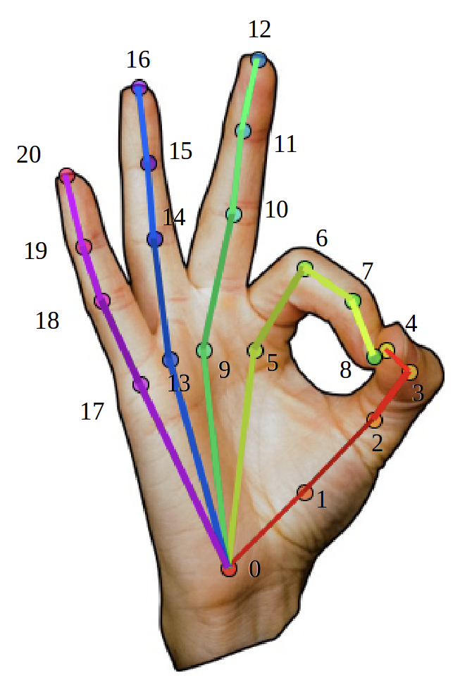
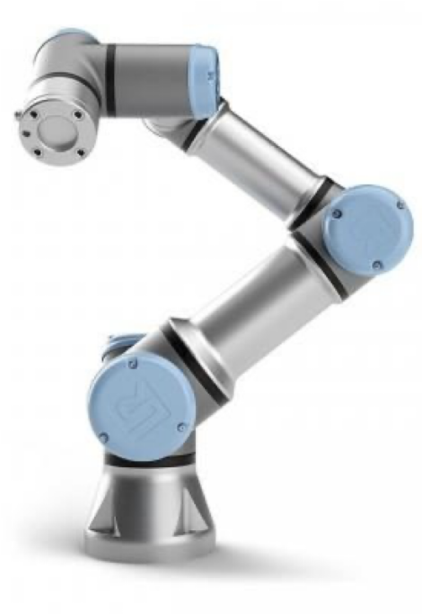
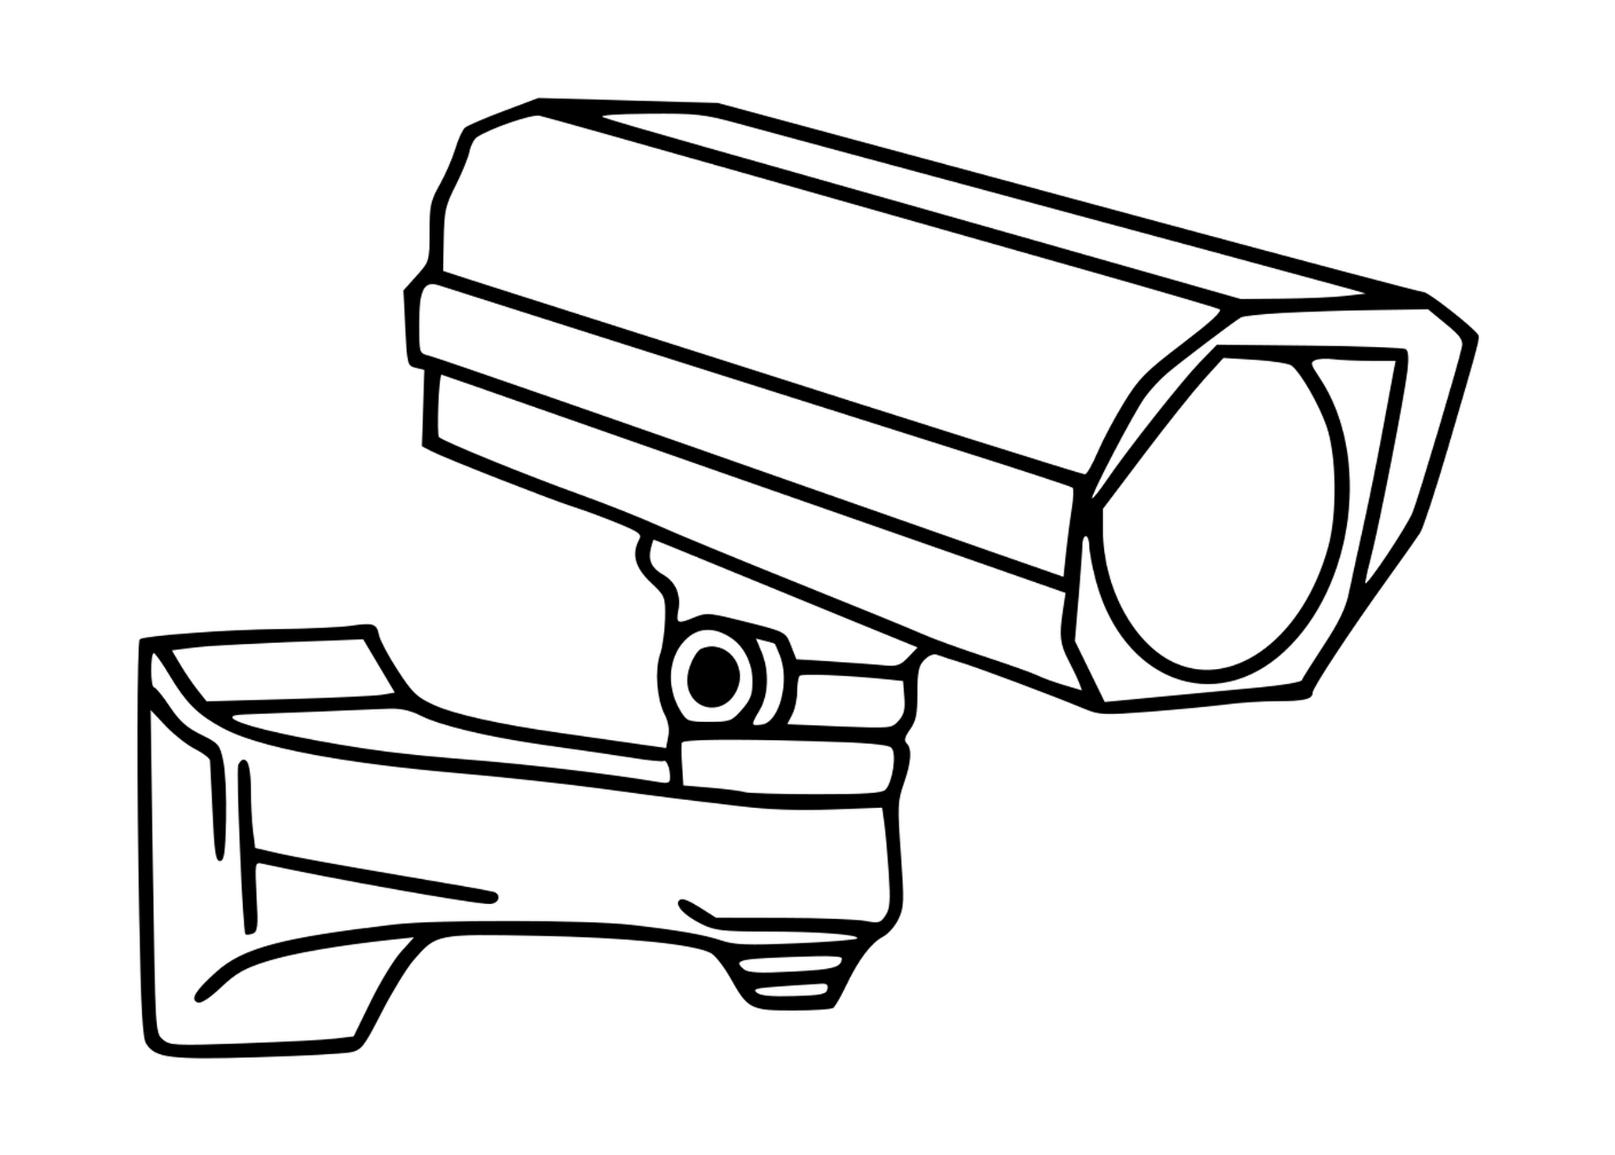
We propose a control scheme to reduce operator cognitive load
Arm Controller

Slide 5
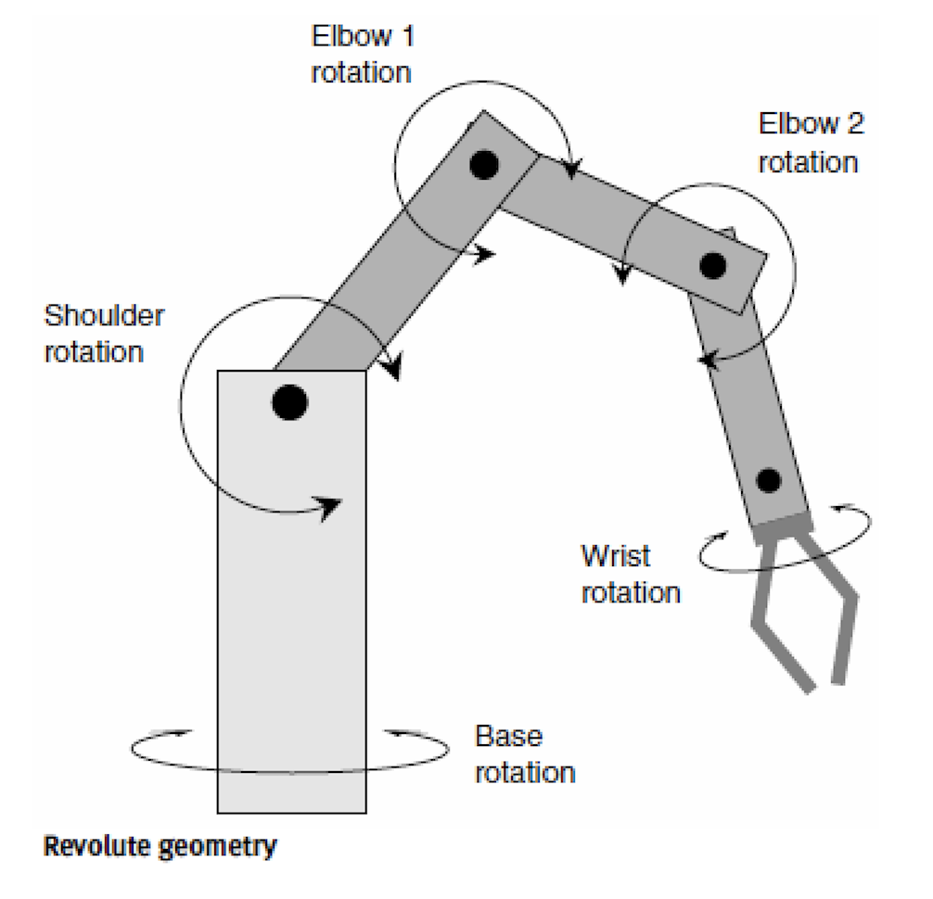
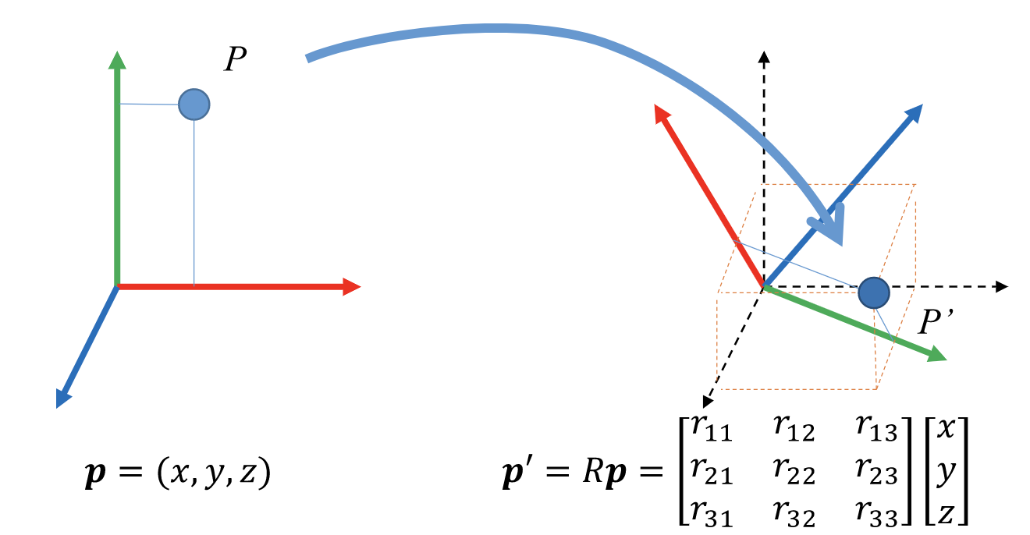
Control Flow:
Stereo camera view of hand
Edge detection and segmentation
Transformation of coordinate system
Illustration of arm movement
Notes:
There are two primary segments of our project. These segments can be recognized as the software and hardware. As far as software goes, we will be using computer vision to detect hand keypoints and we will leverage this to recognize certain hand gestures.
As you can see here we have a general control flow for our process. We will first use pi cameras to detect a hand and apply a segmentation algorithm to detect the edges and keypoints. This information will be translated into a different coordinate system, because the robotic arm does not occupy the same coordinate system as our hand. We must convert the global system (what is observed from our cameras) into arm commands that correspond to the movements and gestures made by a user.

Slide 6
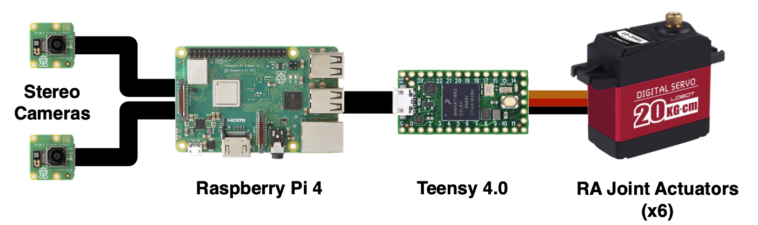
System Architecture:
Notes:
The second important phase of our project is the creation of the physical arm. For the sake of this presentation I will briefly describe the architecture of our system. As you can see the raspberry pi is responsible for controlling our sensing devices, which are cameras.
The raspberry pi will also perform our signal processing and will determine the gestures that are being made, which will then be relayed to the arduino uno through bluetooth communication. Finally the arduino uno will be use to send commands to the six servo motors that control the movement of the robotic arm.

Slide 7
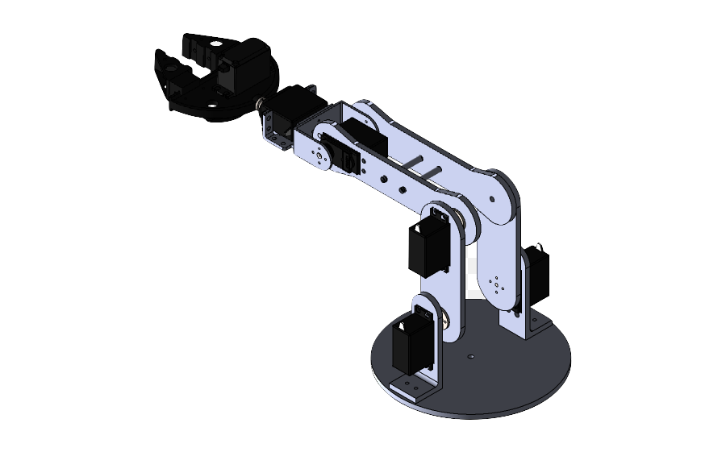
Milestone 1
Hand-to-pose developed
RA hardware decided & begin manufacture
Notes:
Milestone 1: Design Milestone
For Milestone 1, we would like to have a fully developed robotic arm idea and finish the prototypes of the functions we will be designing. For the arm we would like parts to be ready to be ordered by the milestone checkpoint, as well as any manufacturing files such as the support beams and base created in CAD so that we will be able to manufacture them immediately following the milestone review. For the computer hardware we will have selected a serial interface to communicate between the pi and the arduino, we will have selected an appropriate stereo camera for our purposes, we will know power requirements and adapters necessary. We will also have wiring mostly planned out.
A bill of materials should be ready to purchase any items, or collect the items we have on hand. On the code aspect, we will be looking to write function prototypes for both the pi and necessary components. This includes the code for the stereo camera, the filtering system we need for hand detection and the control system for the servo control. We are not aiming to have flushed code at this point, just the method and overarching plan of each subsystem.

Slide 8
How We Get There - 2 teams
Software subteam
Focus solely on accurate arm tracking and camera projection before next meeting
2 members
One works on python hand tracking
One works on projection
Hardware subteam
Focus solely on assembling/debugging the arm before next meeting
2 members
One works on fabing structural parts
One works on parts acquisition
Both work on assembly when ready

Slide 9
Milestone 2
Pose-to-command (Inverse Kinematics)
+
Hardware assembled
Notes:
Milestone 2: Product Milestone
For milestone two we will have the arm completely constructed and able to be moved. That is to say movements of an arm in front of the camera will cause the arm to move. However we do not expect that the system will be fine tuned at this point. The arm may still move unexpectedly or incorrectly, and be impacted by lighting conditions of the room. In addition we do not expect that we will have a gripper at this point but this is the latest we would decide to add one if there is time in the project. As a fallback, if stereo vision is not working we may move to mono-vision and movement in a single plane. If we are having trouble with mimicking specific arm movements we may move to certain gestures meaning certain movements. Depending on the status of our project, we will decide if we will implement the gripper prior to milestone two in order to allow us to have enough time for extensive testing and debugging.

Slide 10
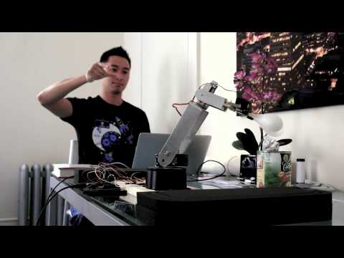
Final Deliverables + Demo
Grabber is a stretch goal
Demo in person with the user trying

Slide 11
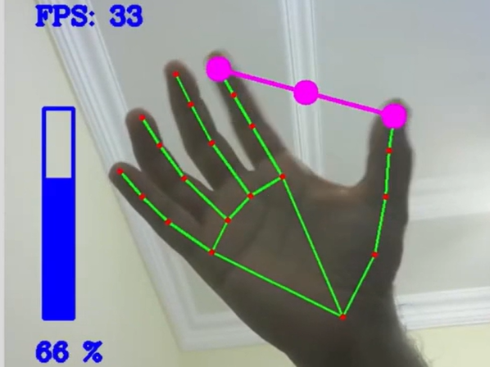
Converting user inputs to manageable information can be challenging
Notes:
Due to class scheduling, we have not officially started the implementation of our design. During our pitch proposal to our instructor we demonstrated the hand tracking pipeline that we will use, which has the ability to extract a hand skeleton segmentation, while also displaying the pixel coordinates that correspond to the input.
For the remainder of the project we must take into account the various different algorithms that are necessary in order to convert visual inputs into information that can effectively control our robot.
The first important aspect is the epipolar geometry that is observed from the two various cameras. The two different pi cameras have a different perspective on a user’s gestures, therefore we must leverage both these perspectives to develop a more concrete view of a user’s movements.
As we have discussed earlier, we must also convert from global coordinates to a robot coordinate system.
And then lastly we must translate this information into corresponding commands that move the robot.

Slide 12
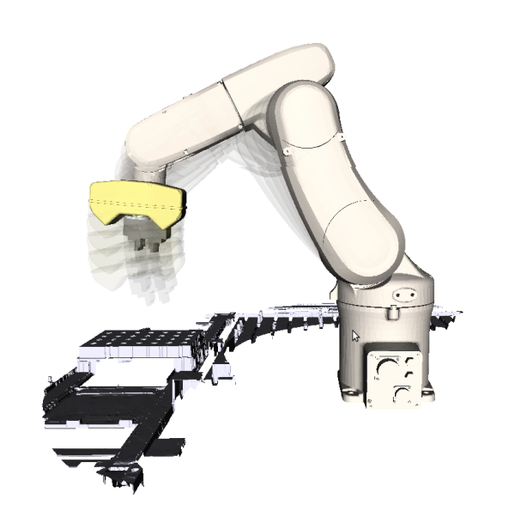
RA motion planning will be challenging
Inverse Kinematics
Self-collisions
Out-of-bounds

